Slide 1

Practical Password Cracking Hardware, Tools, Methods... and AI
Sean T Smith
April 2024

Slide 2

whoami
Name Sean T Smith
Hacker Handle smidiculous
Occupation Smart Factory IIoT Consultant
Another Occupation Cyber Team Lead
Yet Another Occupation Adjunct Professor of Cybersecurity
Family Wife, 2 Kiddos
Education Undergrad, Grad, Google, ChatGPT
Hobbies Tech, Hardware, Building Stuff, 3D Printing, Pretending to Code
My Social Media Links www.seantsmith.me

Slide 3
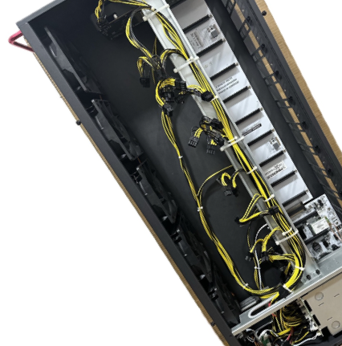
Agenda
Introduction
Password Cracking Factors & Considerations
Overview of Password Attack Types
Recommended Cracking Rigs
The Methodology & Experiment
Tools & Resources for Password Attacks
Walkthrough & Results
Demo
Final Thoughts

Slide 4
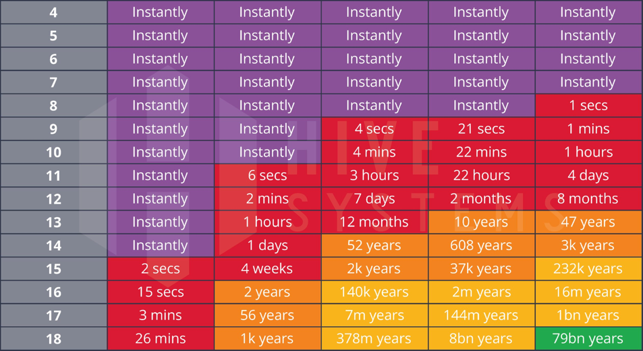
What are we learning today? Password cracking is an exercise in maximizing guesses per unit of time.
ChatGPT Hardware
12x RTX4090 Hardware
This presentation will focus on learning a methodology and mindset which can be applied using many different tools across all password types.
Expensive GPU(s) and Cloud Infrastructure is not required (although it helps); most passwords can be cracked with a laptop.
Bottom line, password cracking is not difficult if you understand the process, I have spent the last 5 years refining my approach during real-world assessments.
Time to share what I’ve learned!
https://www.hivesystems.com/blog/are-your-passwords-in-the-green
Key Hive Systems 2023 Chart Assumptions
Offline Cracking of MD5 Hash
Randomly Generated: a-z, A-Z, 0-9, ^*%$!&@#
Black Box, Password Not Previously Breached

Slide 5
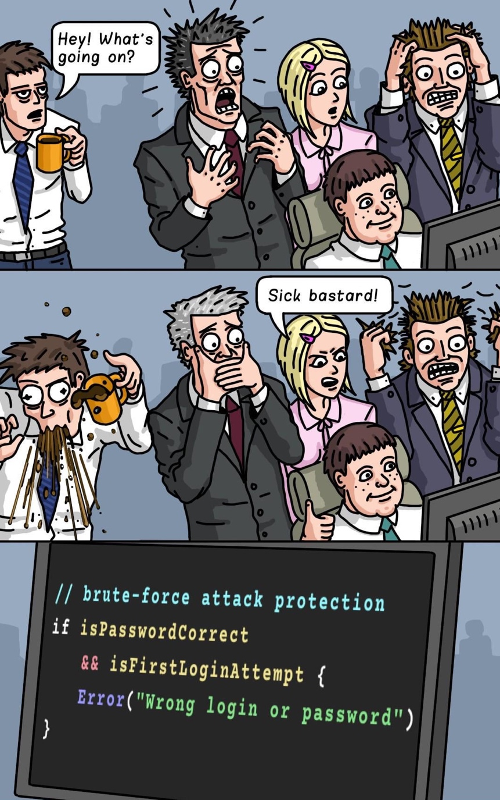
How is this useful? Nothing makes a bigger impact during a cyber assessment than SHOWING the results of poor security practices; password cracking is an easy and useful tool for this.
Penetration testing requires initial access and privilege escalation, frequently this is enabled by cracking captured password hashes.
Successfully cracking password hashes can make the difference between a successful or failed assessment.
Auditing an organizations NTDS.dit file passwords can confirm technical controls of the password policy, or lack thereof!
The skill of password cracking in a time/resource constrained setting is critical for any cyber operator.

Slide 6
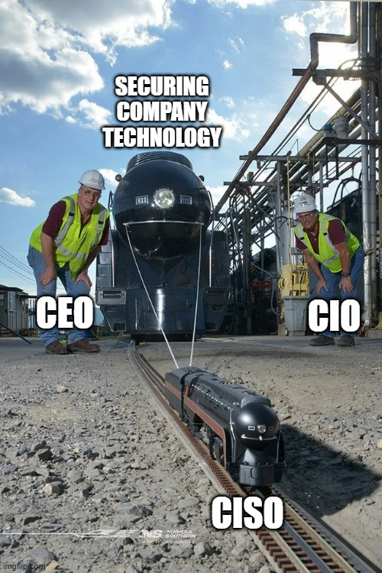
How does this help the good guys? A compelling readout can successfully advocate on behalf of struggling corporate cybersecurity.
Presenting compelling engagement results to the customer’s leadership is intensely effective.
This often leads to swift organizational changes that improve cybersecurity focus and resourcing.
Non-technical leaders can easily relate to exploiting passwords and understand the real-world impact.
It is for this reason that honing your password cracking craft is a critical skill for any Cyber Operator.

Slide 7

The Password Cracking Mindset A pragmatic approach to maximize your cracking probability.
Password Cracking is a Planned Mission
Embrace Complexity Password cracking involves understanding and navigating complex systems. Recognize that each password and security system presents a unique challenge, requiring a thoughtful tailored approach.
Start by Analyzing the Variables These include the type of hash, password strength, available hardware, time constraints, etc. Successful solvers methodically assess these factors before starting.
Develop a Plan After understanding the variables, develop a plan based on the data. Decide the types of attacks and their order ahead of time so that you quickly “pick the lowest hanging fruit” first.
Work Smarter, Not Harder
Leverage Tools & Techniques Familiarize yourself with the plethora of tools and techniques to understand which are best suited for your scenario. Efficiency comes more from using the right tools for the job, not just the most powerful cracking rig.
Understand the Target Understand the target system or password's nature. For example, knowing that a password follows a certain format or that the system has rate limiting can significantly influence your approach and increase efficiency.
Prioritize Targets Prioritize your efforts based on the potential gain and the likelihood of success. This may mean focusing on weaker passwords first or targeting those that grant access to more valuable data.
Patience & Persistence
Trust Your Planning Follow the plan, even if you don’t see success immediately; knowing the time to pivot comes with experience.
Learn Continuously Successful crackers make a habit of learning from each attempt, whether successful or not, and incorporating that information into the future attempts.
“If I had a nickel for every password guess made by my cracking rigs during this research, I would have 18,222,411,116,041,000 nickels... and if that was converted into a stack of $100 bills, it would stretch from the Earth to the Moon and back!”
-Sean Smith
…assisted by ChatGPT

Slide 8




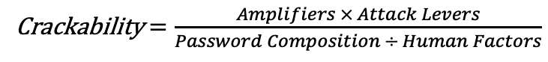
Password Cracking Difficulty Factors
Sean’s Equation for ‘Crackability’
Crackability $=\frac{Amplifiers × Attack Levers}{Password Composition ÷ Human Factors}$
Amplifiers
Password Composition
Human Factors
Tools & Process
Tailored Wordlists
Masks & Rules
AI Models
⇧ Hash Difficulty
⇧ Password
Entropy
Default Password
Previously Breached
Password Reuse
Common Password
Personal Information
Pattern Following
Dictionary Words
Cultural References
Keyboard Walks
Simple Substitutions
Hard
NTLM is cracked
8 Million x Faster
than Bcrypt!
Truly random
passwords.
Attack Levers
⇧ Password
Keyspace
Hard
IMPOSSIBLE
Hard
Cracking
Power
Time
Ouch!
Length & Complexity

Slide 9
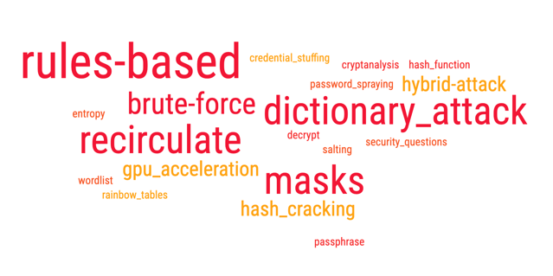
Overview of Our Password Attack Types The Hashcat attacks which underpin the research are listed below.
Base Hashcat Command
{BaseCommand} = hashcat.exe -d 1 -m 1000 -w 4 --username --backend-ignore-hip --bitmap-max 28 --session MySession -o "C:\Users\Sean\Output\output.txt"
Hashcat
Binary
GPU
Device
Hash
Type
Work
Factor
Ignore
Username
Ignore
AMD Error
Increase
Memory
Session
Name
Output
File
Password
Dictionary
Attack
Mode
Hash
List
Attack | Description | Example
Dictionary | Read from a text file (aka ‘dictionary’ or ‘wordlist’) and try each line as a password candidate. | {BaseCommand} -a 0 "C:\Users\Sean\Hashes\password_hashes.txt" "C:\Users\Sean\Dictionaries\dictionary.txt"
Brute-Force | Tries all combinations from a given keyspace (1-8 characters). | {BaseCommand} -a 3 --increment --increment-min=1 "C:\Users\Sean\Hashes\password_hashes.txt" ?a?a?a?a?a?a?a?a
Masks | Try all combinations from a given keyspace, similar to a Brute-Force attack, but more specific. | {BaseCommand} -a 3 "C:\Users\Sean\Hashes\password_hashes.txt" "C:\Users\Sean\Masks\masks.hcmask"
Rules | The rule-based attack is a scripting language which has functions to modify, cut or extend words to generate additional password candidates. | {BaseCommand} -a 0 "C:\Users\Sean\Hashes\password_hashes.txt" "C:\Users\Sean\Dictionaries\dictionary.txt” -r "C:\Users\Sean\Rules\rules.rule"
Recirculate | Apply rules to previously cracked passwords to generate new password candidates. | {BaseCommand} -a 0 "C:\Users\Sean\Hashes\password_hashes.txt" "C:\Users\Sean\Cracked\cracked.txt" -r "C:\Users\Sean\Rules\rules.rule"
LLM-Dictionary | Generate a dictionary of password candidates using a trained LLM model. | {BaseCommand} -a 0 "C:\Users\Sean\Hashes\password_hashes.txt" "C:\Users\Sean\LLM_Model\llm_dictionary.txt"
Single
Mask
Mask
List
Rule
Script
Note: Do not use the [ -O | --optimized-kernel-enable ] switch if you need maximum coverage, instead use the default Pure Kernel.

Slide 10

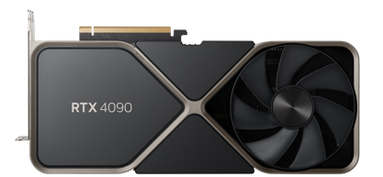
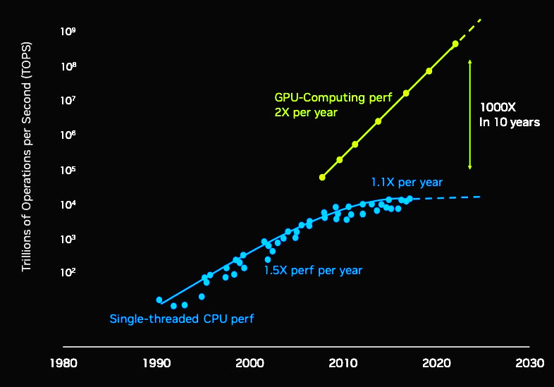
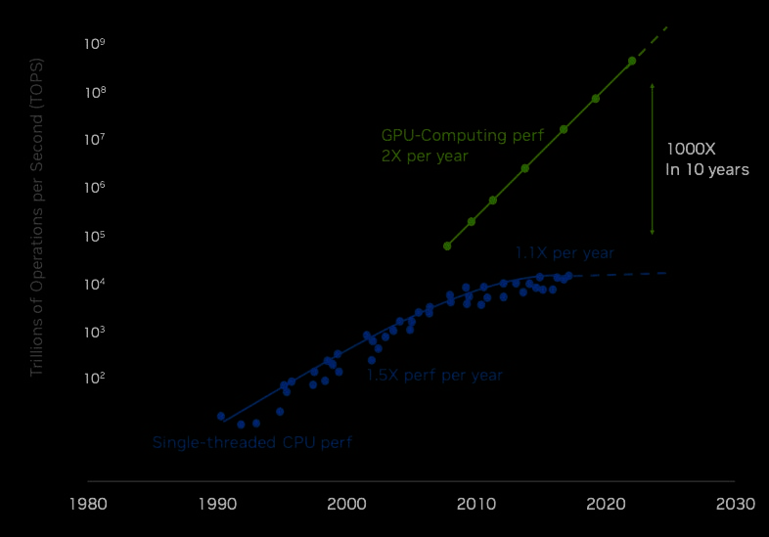
Sourcing GPUs: Which to buy? Buying a single new latest generation graphics card is far better than gambling on used-and-abused older generation cards; > Moore’s Law.
RTX 4090
Founders Edition
GPU Performance has doubled each year!
That means 1,000x growth in 10 years!
1x RTX4090 = 9x GTX1080TI
“But how do I get one for retail, they are all overpriced or sold out?”
-Everyone
Source: Nvidia Q1 FY24 investor presentation
CPU-Computing
www.nowinstock.net
+
Patience

Slide 11
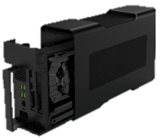
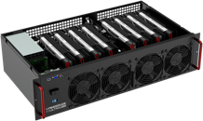
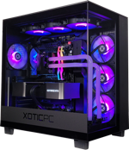

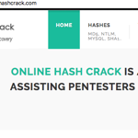
Choosing a Cracking Rig This is my favorite part, but it is actually the least important aspect.
My Pick
Potential Cracking Rigs | Pros | Cons
External Graphics Cards (eGPUs) | Multi-Purpose Dead Simple to Setup I Had Them Already | Supports fewer total GPUs eGPU enclosures are $ Thunderbolt can be unstable
Repurposed Mining Rig | Compact Form Factor Supports Many GPUs Built for Stress | Not Intended for Cracking Weak Compute Minimal RAM & Storage
Use a Gaming Desktop | Built for Graphics Stability Solid Storage & Compute Cool RGB Colors | I don’t have one! My friend wouldn’t stop gaming on his so I could use it.
Cloud Infrastructure | Highly Scalable Easy to Provision Resources | Expensive for my use case. (more on that later)
Online Password Cracking Service | Zero Setup | Expensive and does not support my use case.

Slide 12
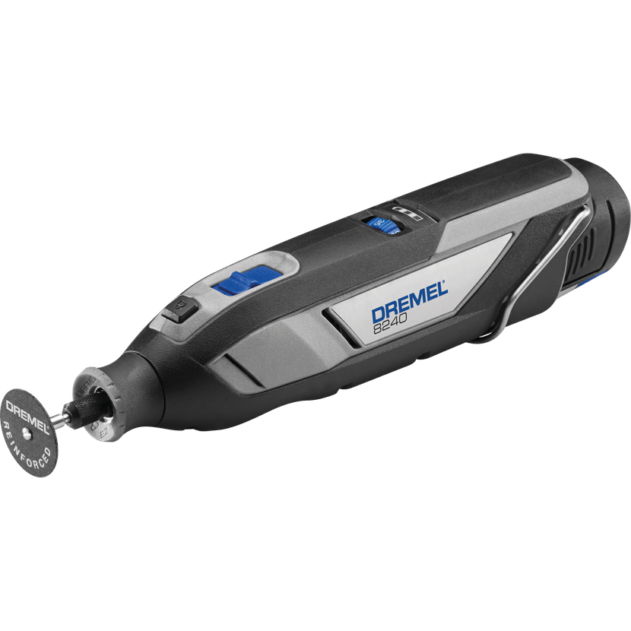
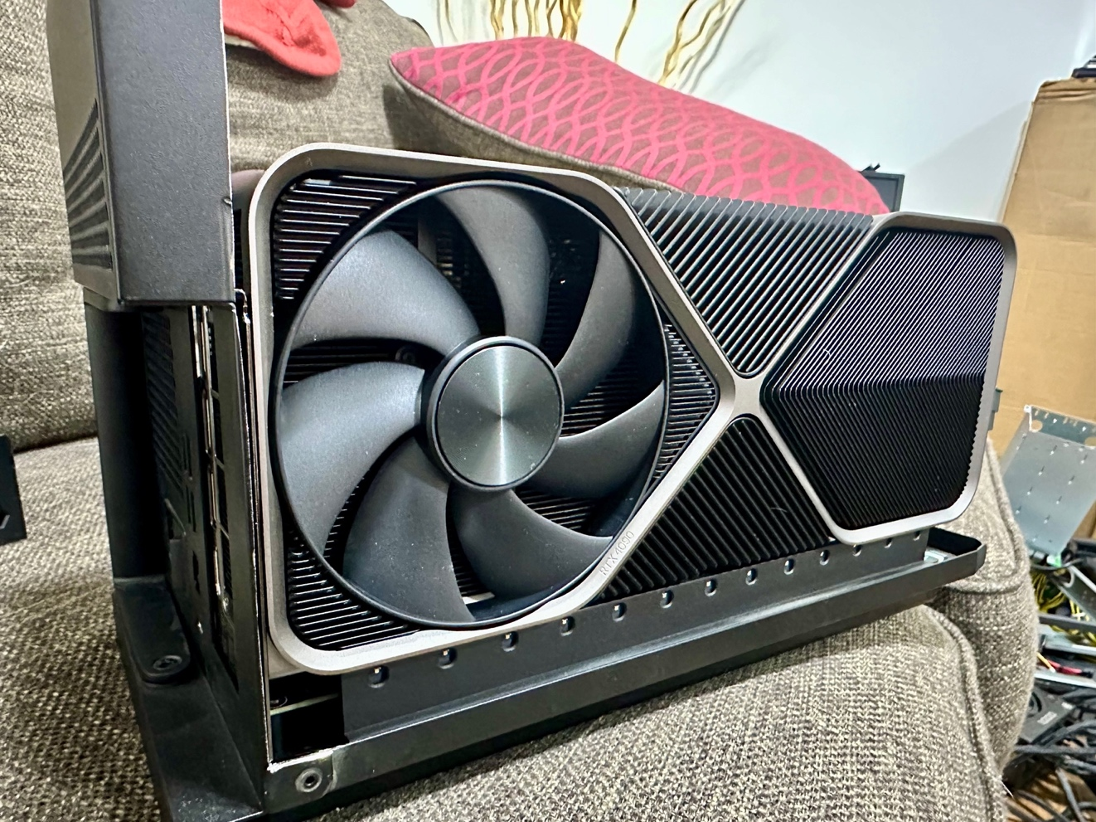
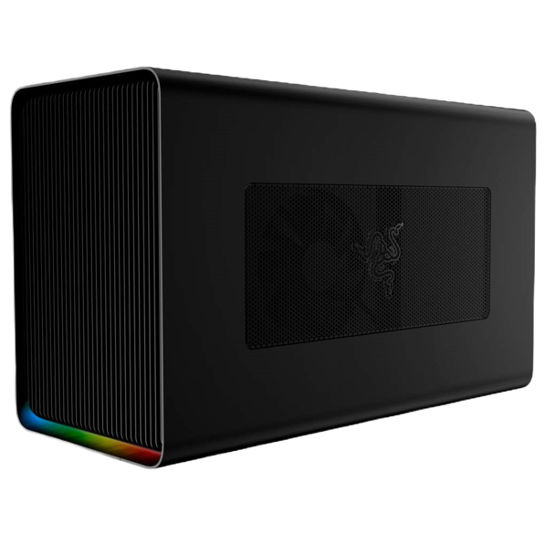

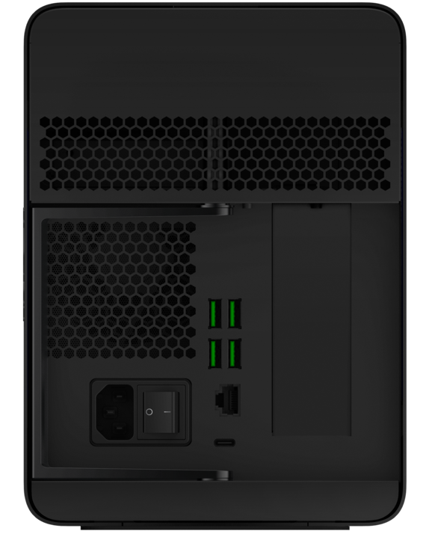
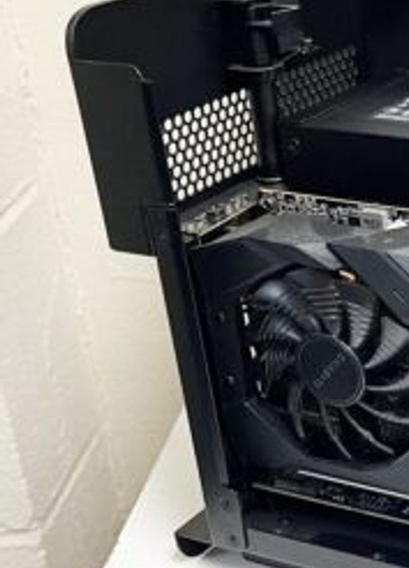
External Graphics Cards (eGPU) I’ve had a lot of success with eGPUs and I value their balance between simplicity, power, flexibility, and portability; connect it to your laptop when you need it! It’s even (barely) compatible with the RTX4090 … after some slight modifications!
Razer Core X Chroma
Sick RGB!
Excellent I/O
700 watt PSU
100 watt PD

Slide 13
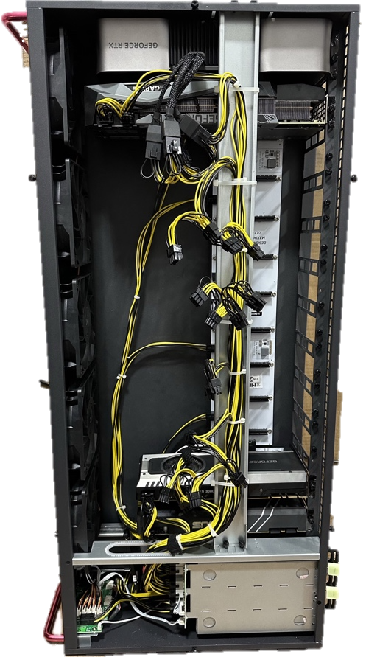
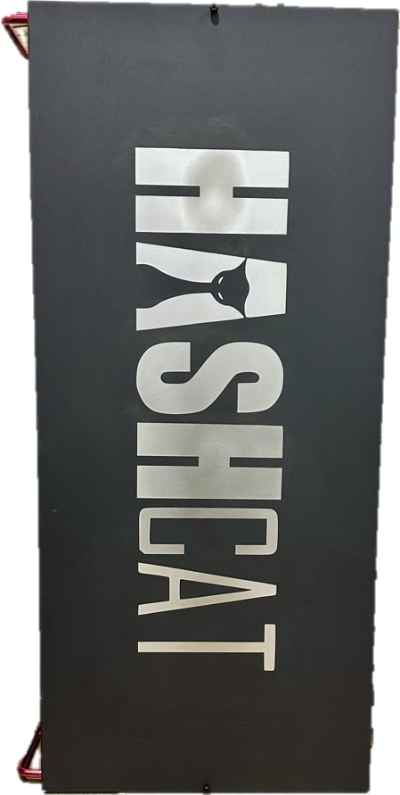

Upgraded Mining Rig MinerDude X12 XTREME = Octominer X12 ULTRA
MinerDude X12 EXTREME
Specs | Default X12 | Upgraded X12
Motherboard | Default w/ PCIe Riser Extension
Processor | Intel G1840 Celeron 2.8Ghz 2-Core | Intel i7-7700T 2.9Ghz, 4-Core
Memory | 8GB DDR3 | 32GB DDR3
Storage | 60GB SATA SSD | 250GB MSATA SSD + 4TB SATA SSD
Power Supply | 3600W@120v | 4200W@240v
Cooling | 5x 140x38mm Fans
Still Not Good Enough…
NEEDS MORE POWER!
Read this, and don’t ignore it like me… https://hashcat.net/forum/thread-11041.html

Slide 14
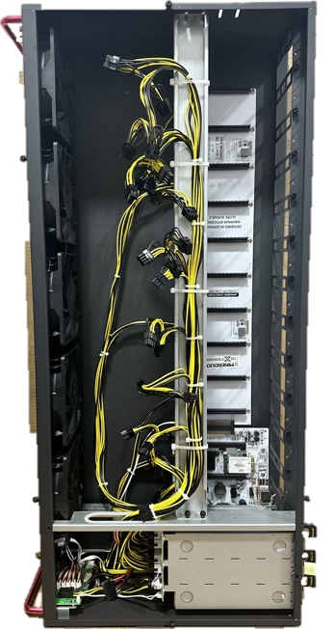


FUTURE UPGRADE: Transformed Mining Rig Replace X12 Motherboard with Biostar TZ590-BTC DUO
Specs | Default X12 | Upgraded X12 | X12 ➜ TZ590-BTC
Motherboard | Default w/ PCIe Riser Extension |  | Biostar TZ590-BTC DUO w/ External PCIe Risers
Processor | Intel G1840 Celeron 2.8Ghz 2-Core | Intel i7-7700T 2.9Ghz, 4-Core | Intel i9-11900T 4.8Ghz, 8-Core, 16-Thread
Memory | 8GB DDR3 | 32GB DDR3 | 128GB DDR4
Storage | 60GB SATA SSD | 250GB SATA SSD + 4TB SATA SSD | 512GB NVME + 4TB NVME
Power Supply | 3600W@120v | 4200W@240v
Cooling | 5x 140x38mm Fans
=== Key Parts List ===
Biostar TZ590-BTC DUO
12x External PCIe Risers
Intel i9-11900T
Noctua NH-L9i Processor Fan
4x G.SKILL TridentZ DDR4-3600 32GB
Samsung 990 Pro 4TB
Silicon Power A55 4TB

Slide 15
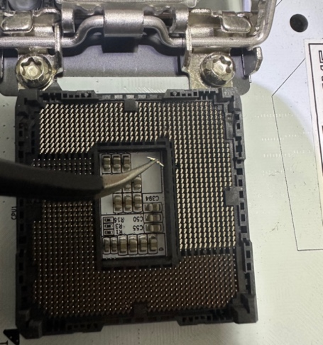
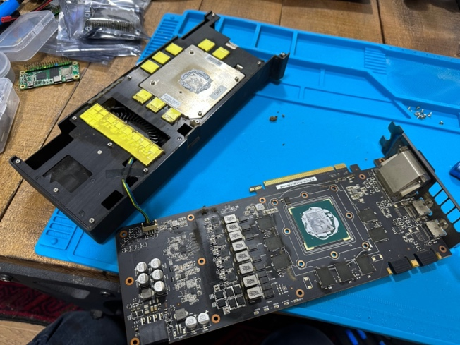
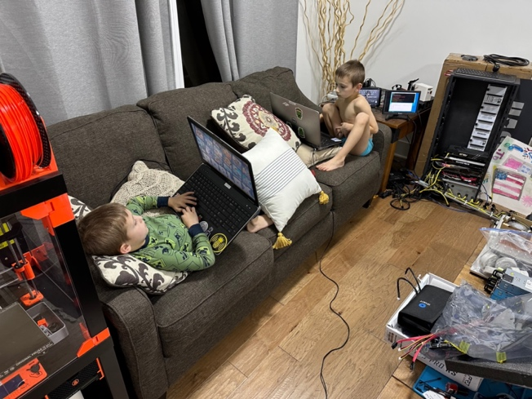
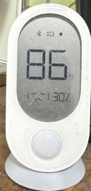
Embrace the Hard(ware)ship. Mistakes were made, things go wrong, the home office gets hot. You can learn from every experience, especially bad ones… and wish you just did this in the Cloud.
Dropped Power Supply on Exposed Socket: Busted Pin
Purchased shady used GPUs on eBay/Facebook: Dirty, Abused & Glitchy
Cracking in the Home Office 24/7: Sweaty Zoom Meetings

Slide 16


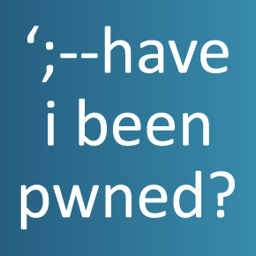
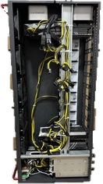


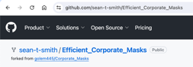


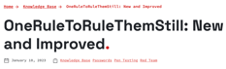
The Experiment Setting the stage to conduct the research.
Goal | To improve upon previous methods to crack unknown ‘hard’ passwords.
Hypothesis | If a Large Language Model (LLM) is trained on an existing set of breached plain text passwords, it will then generate a wordlist of novel but highly probable passwords capable of cracking the difficult and uncracked 9-16 character passwords.
High-Level Approach | Identify a test hash dataset. | Select and gather tools. | Use traditional approach for cracking ‘easy’ passwords. | Leverage LLM to crack ‘hard’ passwords. | Analyze results and present findings.
 | ▼ | ▼ | ▼ | ▼ | ▼
 | Have I Been Pwned Downloader | Hashcat Cracking Rigs | Brute-Force Wordlists Masks Rules | LLM Dictionary | Python MS Excel PowerPoint

Slide 17

Identify a test hash dataset. HaveIBeenPwned.com provides the ideal test dataset because it is clean, contains real passwords as NTLM hashes, and is extremely quick and reliable to download.
HIBP Sample Data
 | Description
Name | Have I Been Pwned (HIBP)
Source | HIBP dataset rolling dataset of breached password hashes. This dataset is the most comprehensive list of public / non-public data breaches from various sources including the FBI. Included along with the hashes are the associated occurrences across breaches which can be used to create interesting outputs.
Data Location | https://haveibeenpwned.com/Passwords
Date D/L | 1/21/2024
File Size | 31.3GB (uncompressed)
Total Hashes | 931,855,073
Hash Type | NTLM
Format | <NTLM_HASH>:<#_OCCURRANCE>
root@kali:~# cat titles.txt && head -n 3 \ ./pwnedpasswords_ntlm.txt && tail -n 3 \ ./pwnedpasswords_ntlm.txt
LINE NUM DATA
000000001 00000001F4A473ED6959F04464F91BB5:4
000000002 000000034C209E9CA85D03512759C405:3
000000003 0000000CEB20FBC9D76790D7F9E6E22B:1
931855071 FFFFFFF3837D006BB13987E0963C9BF3:1
931855072 FFFFFFF439E17F169BBB2216D9C4E4E6:1
931855073 FFFFFFF89C38368724B98C4016622476:4
root@kali:~#

Slide 18
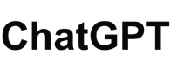

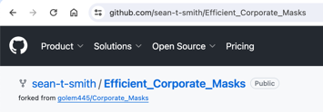

Select and gather [software] tools. The tools & resources which underpin the research are listed below.
Tool / Resources | Link | Description
Hashcat | https://hashcat.net/hashcat https://hashcat.net/wiki https://hashcat.net/wiki/doku.php?id=frequently_asked_questions | The best resource for Hashcat related information is the Hashcat Wiki and FAQ. I recommend reading the both from beginning to end. Hashcat also has verbose errors, if you see an error don’t ignore it, resolve it!
Rules | https://in.security/2023/01/10/oneruletorulethemstill-new-and-improved https://github.com/stealthsploit/OneRuleToRuleThemStill | An improved version of the very popular “OneRuleToRuleThemAll” with improved performance and without any reduction in efficiency.
Masks | https://github.com/sean-t-smith/Efficient_Corporate_Masks/ raw/master/hcmask_Generator_9000.xlsx | A personal project which contains a sortable filterable list of prioritized Hashcat masks. Use this to generate .hcmask files to perform targeted mask attacks.
Wordlists | https://weakpass.com https://weakpass.com/all-in-one | This site is the best repository for high-quality wordlists. The wordlists used in my research are: Top304, brockyou, hk_hlm_founds, hashkiller-dict, HashesOrg, weakpass_3, All-in-One
LLM Model | https://arxiv.org/abs/2306.01545 https://huggingface.co/javirandor/passgpt-10characters https://huggingface.co/javirandor/passgpt-16characters | PassGPT is a causal language model trained on password leaks. It was first introduced in this paper (https://arxiv.org/abs/2306.01545). This version of the model was trained on passwords from the RockYou leak, after filtering those that were at most 16 characters long.
ChatGPT | https://chat.openai.com | Manipulating large datasets requires specialized knowledge of specific tools: PowerShell, Python, sed/awk… but as you know ChatGPT can help with pretty much anything.

Slide 19
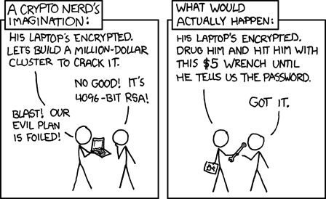
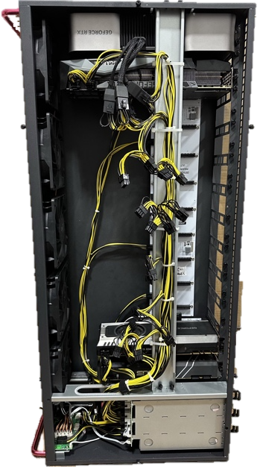


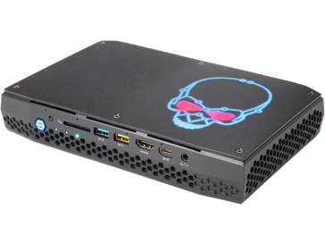
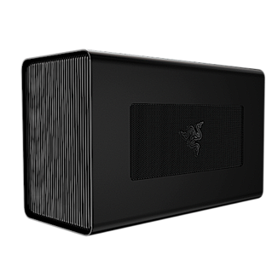
Select and gather [hardware] tools. The tools & resources which underpin the research are listed below.
Framework 13 (AMD)
Laptop | Description
Model | Framework Laptop 13
Processor | Ryzen 7840U, 8-Core
RAM | 64GB DDR5
SSD | 4TB NVME
eGPU Case | Razer Core X Chroma
GPU 1 | RTX 4090
NUC Hades Canyon
Laptop | Description
Model | NUC8i7HVK
Processor | Intel i7-8809G 4-Core
RAM | 64GB DDR4
SSD | 512GB NVME
eGPU Case | Razer Core X
GPU 1 | RTX 3080TI
Octominer x12 Ultra
Laptop | Description
Model | MinerDude X12 XTREME
Processor | Intel i7-7700T, 4-Core
RAM | 32GB DDR3
SSD | 4TB SATA
GPU 1 | RTX 3080
GPU 2,3,4 | 3x GTX 1080

Slide 20

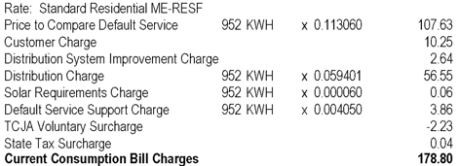

Password Cracking Walkthrough Sweating in the office sauna for 52 days!
Sean’s
Power Bill
Download
HIBP Hash List
Dictionary Breach Compilation + COMB
Dictionary hashes.org HIBP Plains List v1-v7
Brute-Force
1-7 Characters
Brute-Force
8 Characters
0
1
2
3
4
Recirculate + OneRule
Top304
brockyou
hk_hlm_founds
hashkiller-dict
HashesOrg
weakpass_3
Masks
Targeted 10-12 Characters
Masks
Targeted 10 Characters
Masks
Targeted 9 Characters
10
3x
Rules Common Wordlists + OneRule
Brute-Force 13-14 Digits
7
6
5
9
8
Easy
Hard
Dictionary Weakpass
All-In-One
Rules Weakpass All-In-One
+ OneRule
Recirculate + OneRule
LLM-Dictionary PassGPT LLM
Dictionary PassGPT LLM
+ OneRule
Recirculate + OneRule
1x
11
12
13
4x
14
15
16

Slide 21
Password Cracking Timeline The rigs were used for 130 total compute days which would have cost this much with AWS!
AWS Cloud EC2 Equivalency |  |  | As of 3/20/24
EC2 Type | $/Day | Days | Total Cost
g5.4xlarge | $38.98 | 56 | $2,182.66
g5.4xlarge | $38.98 | 37 | $1,442.11
g5.2xlarge | $29.09 | 37 | $1,076.26
https://aws.amazon.com/ec2/instance-types/g5 |  |  | $4,701.02
 |  |  | January |  |  |  |  |  |  |  |  | February |  |  |  |  |  |  |  |  |  |  |  |  |  |  |  |  |  |  |  |  |  |  |  |  |  |  |  |  | March
# | Attack Step | Cracking Rig | 23 | 24 | 25 | 26 | 27 | 28 | 29 | 30 | 31 | 01 | 02 | 03 | 04 | 05 | 06 | 07 | 08 | 09 | 10 | 11 | 12 | 13 | 14 | 15 | 16 | 17 | 18 | 19 | 20 | 21 | 22 | 23 | 24 | 25 | 26 | 27 | 28 | 29 | 01 | 02 | 03 | 04 | 05 | 06 | 07 | 08 | 09 | 10 | 11 | 12 | 13 | 14
 | Breach Compilation + COMB | Framework 13 (AMD) |  |  |  |  |  |  |  |  |  |  |  |  |  |  |  |  |  |  |  |  |  |  |  | 24 | 0 | 0 | 0 | 0 | 0 | 0 | 0 | 0 | 0 | 0 | 0 | 0 | 0 | 0 | 0 | 0 | 0 | 0 | 0 | 0 | 0 | 0 | 0 | 0 | 0 | 0 | 0 | 0
 |  | NUC Hades Canyon |  |  |  |  |  |  |  |  |  |  |  |  |  |  |  |  |  |  |  |  |  |  |  | 24 | 0 | 0 | 0 | 0 | 0 | 0 | 0 | 0 | 0 | 0 | 0 | 0 | 0 | 0 | 0 | 0 | 0 | 0 | 0 | 0 | 0 | 0 | 0 | 0 | 0 | 0 | 0 | 0
 |  | Octominer x12 Ultra |  |  |  |  |  |  |  |  |  |  |  |  |  |  |  |  |  |  |  |  |  |  |  | 24 | 0 | 0 | 0 | 0 | 0 | 0 | 0 | 0 | 0 | 0 | 0 | 0 | 0 | 0 | 0 | 0 | 0 | 0 | 0 | 0 | 0 | 0 | 0 | 0 | 0 | 0 | 0 | 0
 | HIBP Plain List v1 to v7 | Framework 13 (AMD) | 0 | 0 | 0 | 0 | 0 | 0 | 0 | 0 | 0 | 0 | 0 | 0 | 0 | 0 | 0 | 0 | 0 | 0 | 0 | 0 | 0 | 0 | 0 |  |  |  | 4 | 0 | 0 | 0 | 0 | 0 | 0 | 0 | 0 | 0 | 0 | 0 | 0 | 0 | 0 | 0 | 0 | 0 | 0 | 0 | 0 | 0 | 0 | 0 | 0 | 0
 |  | NUC Hades Canyon | 0 | 0 | 0 | 0 | 0 | 0 | 0 | 0 | 0 | 0 | 0 | 0 | 0 | 0 | 0 | 0 | 0 | 0 | 0 | 0 | 0 | 0 | 0 |  |  |  | 4 | 0 | 0 | 0 | 0 | 0 | 0 | 0 | 0 | 0 | 0 | 0 | 0 | 0 | 0 | 0 | 0 | 0 | 0 | 0 | 0 | 0 | 0 | 0 | 0 | 0
 |  | Octominer x12 Ultra | 0 | 0 | 0 | 0 | 0 | 0 | 0 | 0 | 0 | 0 | 0 | 0 | 0 | 0 | 0 | 0 | 0 | 0 | 0 | 0 | 0 | 0 | 0 |  |  |  | 4 | 0 | 0 | 0 | 0 | 0 | 0 | 0 | 0 | 0 | 0 | 0 | 0 | 0 | 0 | 0 | 0 | 0 | 0 | 0 | 0 | 0 | 0 | 0 | 0 | 0
 | Brute Force All Combinations 1-7 Chars | Framework 13 (AMD) | 0 | 0 | 0 | 0 | 0 | 0 | 0 | 0 | 0 | 0 | 0 | 0 | 0 | 0 | 0 | 0 | 0 | 0 | 0 | 0 | 0 | 0 | 0 | 0 | 0 | 0 | 1 | 0 | 0 | 0 | 0 | 0 | 0 | 0 | 0 | 0 | 0 | 0 | 0 | 0 | 0 | 0 | 0 | 0 | 0 | 0 | 0 | 0 | 0 | 0 | 0 | 0
 | Brute Force All Combinations 8 Chars | Framework 13 (AMD) | 0 | 0 | 0 | 0 | 0 | 0 | 0 | 0 | 0 | 0 | 0 | 0 | 0 | 0 | 0 | 0 | 0 | 0 | 0 | 0 | 0 | 0 | 0 | 0 | 0 | 0 | 0 |  |  |  |  |  |  |  |  |  |  | 11 | 0 | 0 | 0 | 0 | 0 | 0 | 0 | 0 | 0 | 0 | 0 | 0 | 0 | 0
 | Targeted Mask Attack (9 chars) | Octominer x12 Ultra | 0 | 0 | 0 | 0 | 0 | 0 | 0 | 0 | 0 | 0 | 0 | 0 | 0 | 0 | 0 | 0 | 0 | 0 | 0 | 0 | 0 | 0 | 0 | 0 | 0 | 0 | 0 | 0 | 0 | 0 | 0 | 0 | 0 |  |  |  |  |  |  |  |  |  | 10 | 0 | 0 | 0 | 0 | 0 | 0 | 0 | 0 | 0
 | Targeted Mask Attack (10 chars) | Framework 13 (AMD) | 0 | 0 | 0 | 0 | 0 | 0 | 0 | 0 | 0 | 0 | 0 | 0 | 0 | 0 | 0 | 0 | 0 | 0 | 0 | 0 | 0 | 0 | 0 | 0 | 0 | 0 | 0 | 0 | 0 | 0 | 0 | 0 | 0 |  | 0 | 0 | 0 |  |  |  |  |  | 6 | 0 | 0 | 0 | 0 | 0 | 0 | 0 | 0 | 0
 | Targeted Mask Attack (11-12 chars) | NUC Hades Canyon | 0 | 0 | 0 | 0 | 0 | 0 | 0 | 0 | 0 | 0 | 0 | 0 | 0 | 0 | 0 | 0 | 0 | 0 | 0 | 0 | 0 | 0 | 0 | 0 | 0 | 0 | 0 | 0 | 0 | 0 | 0 | 0 | 0 |  |  |  |  |  |  |  |  |  | 10 | 0 | 0 | 0 | 0 | 0 | 0 | 0 | 0 | 0
 | Mask Attack (13-14 digits) | Framework 13 (AMD) | 0 | 0 | 0 | 0 | 0 | 0 | 0 | 0 | 0 | 0 | 0 | 0 | 0 | 0 | 0 | 0 | 0 | 0 | 0 | 0 | 0 | 0 | 0 | 0 | 0 | 0 | 0 | 0 | 0 | 0 | 0 | 0 | 0 | 0 | 0 | 0 | 0 | 0 | 0 | 0 | 0 | 0 | 1 | 0 | 0 | 0 | 0 | 0 | 0 | 0 | 0 | 0
 | Rule-based (Wordlists + OneRule) Attack | Framework 13 (AMD) | 0 | 0 | 0 | 0 | 0 | 0 | 0 | 0 | 0 | 0 | 0 | 0 | 0 | 0 | 0 | 0 | 0 | 0 | 0 | 0 | 0 | 0 | 0 | 0 | 0 | 0 | 0 | 0 | 0 | 0 | 0 | 0 | 0 | 0 | 0 | 0 | 0 | 0 | 0 | 0 | 0 | 0 |  |  |  | 4 | 0 | 0 | 0 | 0 | 0 | 0
 | Recirculate + OneRule Attack (3 Rounds) | Framework 13 (AMD) | 0 | 0 | 0 | 0 | 0 | 0 | 0 | 0 | 0 | 0 | 0 | 0 | 0 | 0 | 0 | 0 | 0 | 0 | 0 | 0 | 0 | 0 | 0 | 0 | 0 | 0 | 0 | 0 | 0 | 0 | 0 | 0 | 0 | 0 | 0 | 0 | 0 | 0 | 0 | 0 | 0 | 0 | 0 | 0 | 0 | 0 | 1 | 0 | 0 | 0 | 0 | 0
 | Weakpass All-in-One (full) | Framework 13 (AMD) | 0 | 0 | 0 | 0 | 0 | 0 | 0 | 0 | 0 | 0 | 0 | 0 | 0 | 0 | 0 | 0 | 0 | 0 | 0 | 0 | 0 | 0 | 0 | 0 | 0 | 0 | 0 | 0 | 0 | 0 | 0 | 0 | 0 | 0 | 0 | 0 | 0 | 0 | 0 | 0 | 0 | 0 | 0 | 0 | 0 | 0 |  | 2 | 0 | 0 | 0 | 0
 | Weakpass All-in-One (full) + OneRule | Framework 13 (AMD) | 0 | 0 | 0 | 0 | 0 | 0 | 0 | 0 | 0 | 0 | 0 | 0 | 0 | 0 | 0 | 0 | 0 | 0 | 0 | 0 | 0 | 0 | 0 | 0 | 0 | 0 | 0 | 0 | 0 | 0 | 0 | 0 | 0 | 0 | 0 | 0 | 0 | 0 | 0 | 0 | 0 | 0 | 0 | 0 | 0 | 0 | 0 |  |  |  | 4 | 0
 | Recirculate + OneRule Attack (4 Rounds) | Framework 13 (AMD) | 0 | 0 | 0 | 0 | 0 | 0 | 0 | 0 | 0 | 0 | 0 | 0 | 0 | 0 | 0 | 0 | 0 | 0 | 0 | 0 | 0 | 0 | 0 | 0 | 0 | 0 | 0 | 0 | 0 | 0 | 0 | 0 | 0 | 0 | 0 | 0 | 0 | 0 | 0 | 0 | 0 | 0 | 0 | 0 | 0 | 0 | 0 | 0 | 0 | 0 | 1 | 0
 | PassGPT LLM Wordlist Attack | Framework 13 (AMD) | 0 | 0 | 0 | 0 | 0 | 0 | 0 | 0 | 0 | 0 | 0 | 0 | 0 | 0 | 0 | 0 | 0 | 0 | 0 | 0 | 0 | 0 | 0 | 0 | 0 | 0 | 0 | 0 | 0 | 0 | 0 | 0 | 0 | 0 | 0 | 0 | 0 | 0 | 0 | 0 | 0 | 0 | 0 | 0 | 0 | 0 | 0 | 0 | 0 | 0 | 0 | 1
 | LLM Wordlist (PassGPT) + OneRule Attack | Framework 13 (AMD) | 0 | 0 | 0 | 0 | 0 | 0 | 0 | 0 | 0 | 0 | 0 | 0 | 0 | 0 | 0 | 0 | 0 | 0 | 0 | 0 | 0 | 0 | 0 | 0 | 0 | 0 | 0 | 0 | 0 | 0 | 0 | 0 | 0 | 0 | 0 | 0 | 0 | 0 | 0 | 0 | 0 | 0 | 0 | 0 | 0 | 0 | 0 | 0 | 0 | 0 | 0 | 1
 | Recirculate + OneRule Attack (1 Round) | Framework 13 (AMD) | 0 | 0 | 0 | 0 | 0 | 0 | 0 | 0 | 0 | 0 | 0 | 0 | 0 | 0 | 0 | 0 | 0 | 0 | 0 | 0 | 0 | 0 | 0 | 0 | 0 | 0 | 0 | 0 | 0 | 0 | 0 | 0 | 0 | 0 | 0 | 0 | 0 | 0 | 0 | 0 | 0 | 0 | 0 | 0 | 0 | 0 | 0 | 0 | 0 | 0 | 0 | 1
1
2
3
4
5
6
7
8
9
10
11
12
13
14
15
16

Slide 22

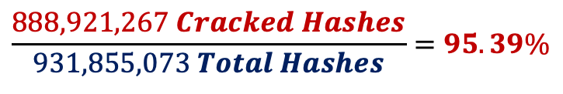
Summarized Results The methodology cracked over 95% of the Have I Been Pwned hash dataset!
$$\frac{888,921,267 Cracked Hashes}{931,855,073 Total Hashes}=95.39\%$$
31
GB
31
GB
6.7
GB
4.5
GB
4.3
GB
3.9
GB
3.5
GB
3.0
GB
2.8
GB
2.8
GB
1.9
GB
1.7
GB
1.6
GB
1.5
GB
1.5
GB
1.5
GB
1.4
GB
+
0.3%
0
1
2
3
4
5
6
7
8
9
10
11
12
13
14
15
16

Slide 23



Was the LLM-Dictionary attack successful? The LLM-Dictionary attack cracked more passwords per total guesses than the Weakpass All-in-One attack, even being last in the attack order!
# | Phase | Attack Keyspace | Uncracked | % | Size | Cracked | % | Size
0 | HIBP Dataset | - | 931,855,073 | 100.0% | 31.3GB | - | 0.0% | 0.0GB
1 | Breach Compilation + COMB (102GB) | 8,775,988,939 | 184,698,787 | 19.8% | 6.7GB | 747,156,286 | 80.2% | 33.2GB
2 | HIBP Plain List v1 to v7 (8GB) | 624,156,006 | 124,991,382 | 13.4% | 4.5GB | 59,707,405 | 6.4% | 36.2GB
3 | Brute Force All Combinations 1-7 Chars | 70,576,641,626,495 | 120,052,757 | 12.9% | 4.3GB | 4,938,625 | 0.5% | 36.4GB
4 | Brute Force All Combinations 8 Chars | 6,634,204,312,890,620 | 107,004,666 | 11.5% | 3.9GB | 13,048,091 | 1.4% | 37.0GB
5 | Targeted Mask Attack (9 chars) | 2,663,175,327,420,910 | 96,407,321 | 10.3% | 3.5GB | 10,597,345 | 1.1% | 37.6GB
6 | Targeted Mask Attack (10 chars) | 3,047,124,553,245,060 | 86,112,207 | 9.2% | 3.0GB | 10,295,114 | 1.1% | 38.3GB
7 | Targeted Mask Attack (11-12 chars) | 4,039,055,493,990,400 | 80,776,718 | 8.7% | 2.8GB | 5,335,489 | 0.6% | 38.5GB
8 | Mask Attack (13-14 digits) | 110,000,000,000,000 | 80,531,094 | 8.6% | 2.8GB | 245,624 | 0.0% | 38.5GB
9 | Rule-based (Wordlists + OneRule) Attack | 161,864,881,597,555 | 53,178,940 | 5.7% | 1.9GB | 27,352,154 | 2.9% | 39.7GB
10 | Recirculate + OneRule Attack (3 Rounds) | 85,267,558,724,478 | 48,080,063 | 5.2% | 1.7GB | 5,098,877 | 0.5% | 40.0GB
11 | Weakpass All-in-One (full) | 28,330,556,550 | 45,877,005 | 4.9% | 1.6GB | 2,203,058 | 0.2% | 40.1GB
12 | Weakpass All-in-One (full) + OneRule | 1,371,595,564,811,700 | 43,718,518 | 4.7% | 1.5GB | 2,158,487 | 0.2% | 40.3GB
13 | Recirculate + OneRule Attack (4 Rounds) | 238,916,699,352 | 43,087,510 | 4.6% | 1.5GB | 631,008 | 0.1% | 40.3GB
14 | PassGPT LLM Wordlist Attack (8.64GB) | 810,980,079 | 43,087,251 | 4.6% | 1.5GB | 259 | 0.0% | 40.3GB
15 | LLM Wordlist (PassGPT) + OneRule Attack | 39,262,789,544,706 | 42,952,553 | 4.6% | 1.4GB | 134,698 | 0.0% | 40.4GB
16 | Recirculate + OneRule Attack (1 Round) | 6,533,808,198 | 42,933,806 | 4.6% | 1.4GB | 18,747 | 0.0% | 40.4GB
 | OVERALL RESULTS: | 18,222,411,116,041,000 | 42,933,806 | 4.61% | 1.44GB | 888,921,267 | 95.39% | 40.41GB
Weakpass All-in-One Steps 11 + 12 + 13
Dictionary Size | 329GB
Cracked | 4,992,553
Keyspace | 1,371,862,812,067,600
Guess Efficiency (Cracked/Keyspace) | 3.64E-09 -7%
PassGPT LLM Steps 14 + 15 + 16
Dictionary Size | 8.64GB
Cracked | 153,704
Keyspace | 39,270,134,332,983
Guess Efficiency (Cracked/Keyspace) | 3.91E-09 +8%

Slide 24
A small peak into some cracked hashes. Here is the proof -- the model successfully cracked never-before-cracked hashes!
Most Popular | Passwords
Top 15
Most Popular | Mask Patterns
Top 10
42542807:123456
18313580:123456789
10713794:qwerty
10382543:password
6901438:12345678
5070941:111111
4880569:qwerty123
4486025:1q2w3e
4351342:1234567
4130502:1234567890
4034851:abc123
3897129:123123
3663338:NULL
3561705:DEFAULT
3508324:12345
481526598:?l?l?l?l?l?l?l?l
321100471:?l?l?l?l?l?l
319361204:?d?d?d?d?d?d
225430345:?l?l?l?l?l?l?l
215320674:?d?d?d?d?d?d?d?d
205251980:?l?l?l?l?l?l?d?d
144530489:?l?l?l?l?l?l?l?l?l
126303027:?l?l?l?l?l?l?l?d
123240391:?l?l?l?l?l?l?l?l?l?l
122936007:?l?l?l?l?l?l?d
1. PassGPT Wordlist
259 Cracked
e95fbaa8fafac04d0141a42c717fc541:burgosfresa
f5244f78c0757cb2babc95b44382ed98:MorbidDiana
e17f17609ab95ef91231b2c4b85bac49:LASVEGAS&ME
577d9c1e13f042740d84b47ac7c48180:ABCabc123ert
55ad51225157a4aff52205b2448d7bbd:eulogiomateo
44e949e8e4d7c6633e38b6c5843b183f:12_sept_1987
11edda3c45bb636df4a5e43e779f37f8:amoremiopaulo
357d8f9c5d0f96653b7e7cf3ecd0ff26:1968ScoobyDoo
69f938370dbfc0090a5162f0fa32dce8:hidalgoferrer
0e62a5b96e4831f302912e192d372651:blazeandlottie
45c8710982905da7305fae54d1c86582:camiloesunbobo
b3d9b4c4ef945e047f345c321746dc09:milagrosteodio
7f58bfeb7be4ecb6d8b08c3b936a7653:figueroaventura
76153fc02710dbb8508e2dd5f580478e:iliketosucktoes
45f1b0807997acfa2b4af1d01f19dda3:medranotequiero
c5f6ae53328705d7e1ab1f22ee72cdeb:queenofdangerous
1e88268ad6af32bbb9b79a31338e626f:zacefronxsiempre
a5c1acba5783404f8ddf14e3eaad0b23:12369874!@#$%^&*
2. PassGPT Wordlist + OneRule
134,698 Cracked
82e3aeb7bc2565e9e0317cbc465563c8:mu1ba23re
058fbc9de5c6ab6a4399345455c6e35b:sunnySKE11
9c1c51026d6308e475bb0bf38a47b2f7:killerLSA23
214fd681c216f84cb7758c0ffb3b01cf:leandroMSP89
1333553437499be7ffd327c0a564ec76:facebookLoL15
bc31f1e63c9bae69ff5cfb950809a658:computeritb747
7cdc17db713fbfa645ff95308a5ced6e:alexandre09tuna
515fe0444b00ba04fddfae5431e6038e:alma1***********
d8080ebac595632350a90ffeb429d2cb:taylorswiftjcww12
9097daf5de29e2adfbbe461130d9c796:yosoyunkkkkkkkkkkk
545d4e6c4c30cc1613fe6ad23e3c346f:mortalkombats192903
f920d33ba4efd7a80332c5d34b4be6a0:lamborghini700spyder
4c7eae92597f53c0fdaf6424aea19c8e:123456789saramagnante
5568d1983f5d9aa88f7d915b7e0e74a5:ssaajjaa112233445566**
dde00f08e3d32f205ca705905cad4e56:paradiseloser1234567890
88a231361ba96e0310b73c257807a1d0:undertaker30wrestlemania
6fef3ca1a479d7df4938195ce83ed73c:policeisawesome1234567890
e44943afe2dbc7361a2b29e63921d56b:ilovememeloveyou1234567890
500d718e9513dd1b862cd82eb46969df:014578163014578163014578163
269333027e5dbd338fc11ed77c808d6b:Diosesamor2324Diosesamor2324
bc75daf180ae8932cac63849572c6be6:mmp12345678910mmp12345678910
5d935bac3b260329de4292a368518301:086830532508683053250868305325
a367dc2ae9a963d696d19238ac33d887:16septiembre200416septiembre2004
3c636198145c5d256bfd179d66352ac1:4nn2nn34nn2nn34nn2nn34nn2nn34nn2nn3
f6a36bdb507192df6e0a14efdcdb9c98:arielminiarielminiarielminiarielmini
be490ad4021821bdde2445ec432e5809:0012101911001210191100121019110012101911
3. Recirculate + OneRule
18,747 Cracked
19890b1ab584f482338bc7cd5f4efd38:Ss@123=12
991bdf8334f6821fca9258e8949a2ad8:Lisa*emma2
ebf6cdde011b455f1f1b3048e5d9ad63:Kimshgood1!
b347a9e099a0b80de4b259aedcffaaee:kkisskkutya1
b8cd92afb7325ab4fb5ebc669fc10443:Patchieepeach
c6e74525c172fa5c98d4ecdf17af1e62:258258546852sm
cdb0fcd1877db57bdc653f2edce1d4f2:12341234VIDA123
2aedc5cc31efec54eab690b9965df93e:1707199521212301
9918ee06afb86f6e221191dca5ff6159:Ikertorrescabello
37f453b9f2343425bbf24cc22d09d67a:Eventy199419941994
1f8bc7b5572ecb61c901ff2514fe029a:Dragonballgodboi02!
3450d5450844c5c20a1469e256bf1b6d:Alejo2007patrick2007
9eb89ed416bf9f22019b9ff2f516b0f8:Fatimavaleriadaniela1
5300fb27045762d4a04d74c147e88751:endutsilandendutsiland
18eea0c4b17e19fb6c631718ba56406a:Argentina2020porsiempre
14d3375fccd50f5dc260641aef7425e8:elenateamopadreteamo0719
4dd66d3634c756a6f9d0c29c0eb1dc8c:Policeisawesome1234567890.
dee2d7efd83d802be253f66e8bee8c17:VALENTINA123456789LISETTEEE
b10d1a02987113cc6cd9729642afee09:yamahafr940228yamahafr940228
bda5ffd3bab2fd1a845514bd797f032f:poopyhead154144poopyhead154144
Now let’s take the model for a spin…

Slide 25

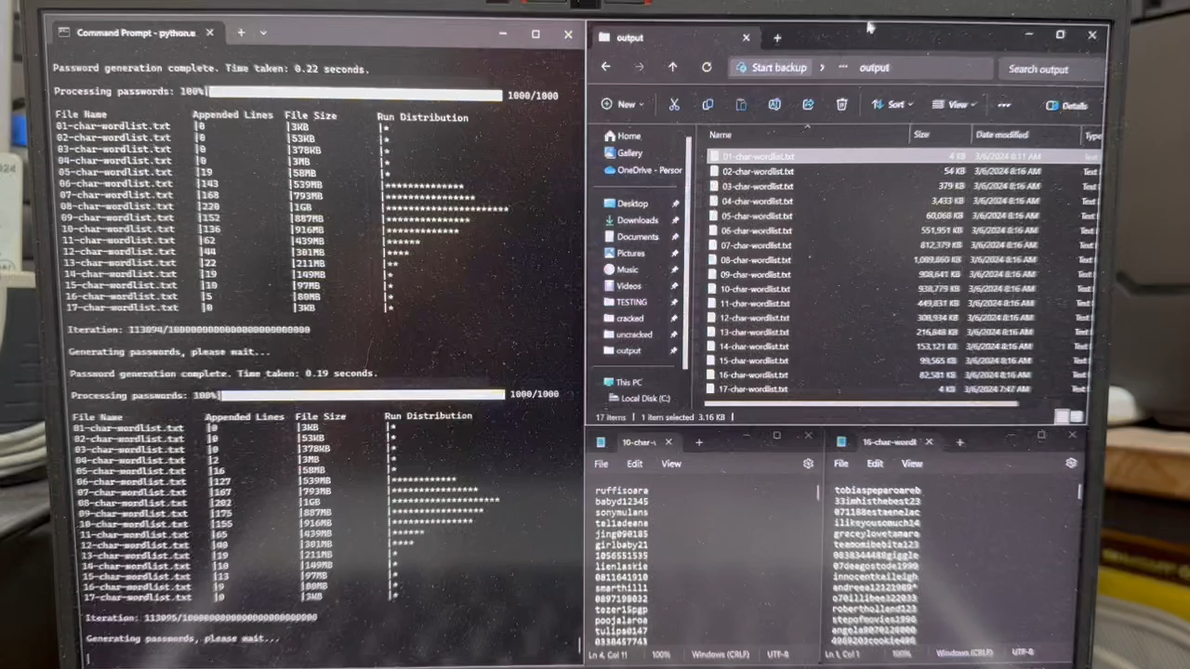
 Demo Time  When things go terribly wrong…
►
https://youtu.be/<TBD>

Slide 26
Final Thoughts & Surprises Thanks for coming, I will make this presentation, some data, and tools public on my GitHub page, happy hacking!
AWS is Expensive - Why rent when you can own?
PII in Passwords - Email addresses, full names, birthdays.
External Thunderbolt NVME - Makes transporting large files easy.
Leave No Hash Behind - Data integrity after processing is tricky.
Read Hashcat’s Documentation - There are a lot of awesome tools.
ChatGPT - Makes writing scripts extremely accessible for all.
Huge Thank You to PassGPT Team - They provided access to their non-public 16-character model for educational use. PassGPT Password Modeling and (Guided) Generation with Large Language Models: Javier Rando, Fernando Perez-Cruz, Briland Hitaj

Slide 27



Thank you!
Sean T Smith www.seantsmith.me
linkedin.com/in/seantsmith
twitter.com/sts5017
github.com/sean-t-smith

